Slide 1
CS 211 Computer Architecture Lecture 21: RISC-V Machine Instructions - 2
Ravi Mittal
ravi.mittal@iitgoa.ac.in
Indian Institute of Technology, Goa

Slide 2
Acknowledgements
Class Presentation, CS61C, Introduction to Assembly Language and RISC-V Instruction Set Architecture, University of Berkeley, Prof Krste Asanović & Randy H. Katz. http://inst.eecs.Berkeley.edu/~cs61c
Book: Digital Design and Computer Architecture: RISC-V Edition, Harris & Harris Elsevier – Presentation.
Computer Organization and Design, The Hardware Software Interface, RISC-V edition, Patterson and Hennessey

Slide 3
RISC-V: So far we have studied
Arithmetic operations: add, sub, addi,
How to bring data from memory to register and vice versa?
lw, sw, lb, sb, lbu
Bit-by-bit logical instructions
and, or, xor
andi, ori, xori
Logical Shift instructions
sll, srl, sra, slli, srli, srai
Generating Constants
Branching Instructions: beq, bne, blt/bltu, bge/bgeu
Jumping instruction: j
Assembly level program for: if, if/else, while, for loops
Function Calls
Basics
Input arguments and Return Value
The Stack
Basics
How functions use a stack
Stack use in non-leaf function calls
Recursive Functions
Floating Point Numbers
Instruction Formats
R-Format Instructions

Slide 4
In this class we will study
Instruction Formats
I-format
S-format
B-format
U-format

Slide 5
RISC-V Instruction Formats Introduction (Revision)

Slide 6
Instructions Format
One word is 32 bits, so divide instruction word into “fields”
Each field tells processor something about instruction
We could define different fields for each instruction, but RISC-V seeks simplicity, so define six basic types of instruction formats:
R-format for register-register arithmetic operations
I-format for register-immediate arithmetic operations and loads
S-format for stores
B-format for branches (minor variant of S-format, called SB before)
U-format for 20-bit upper immediate instructions
J-format for jumps (minor variant of U-format, called UJ before)
Prof Krste Asanović & Randy H. Katz, Univ of California, Berkeley

Slide 7
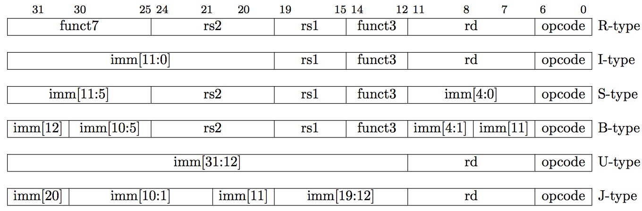
Summary of RISC-V Instruction Formats
Prof Krste Asanović & Randy H. Katz, Univ of California, Berkeley

Slide 8
I-Format

Slide 9
I-Format Instructions
What about instructions with immediates?
5-bit field only represents numbers up to the value 31 – too small= immediates must be larger than this
Ideally, RISC-V would have only one instruction format (for simplicity): unfortunately, we need to compromise
Define new instruction format that is mostly consistent with R-format
Notice if instruction has immediate, then uses at most 2 registers (one source, one destination)
Prof Krste Asanović & Randy H. Katz, Univ of California, Berkeley

Slide 10
I-Format Instruction Layout
Only one field is different from R-format, rs2 and funct7 replaced by 12-bit signed immediate, imm[11:0]
Remaining fields (rs1, funct3, rd, opcode) same as before
imm[11:0] can hold values in range [-2048_{ten} , +2047_{ten} ]
12-bit two’s compliment immediate
Immediate is always sign-extended to 32-bits before use in an arithmetic operation
We’ll later see how to handle immediates > 12 bits
Prof Krste Asanović & Randy H. Katz, Univ of California, Berkeley

Slide 11
I-Format Example
RISC-V Assembly Instruction:
addi x15,x1,-50
111111001110
00001
000
01111
0010011
imm=-50
rs1=1
ADD
rd=15
OPCODE-Imm
hex representation: 0x FCE0 8793
Prof Krste Asanović & Randy H. Katz, Univ of California, Berkeley

Slide 12
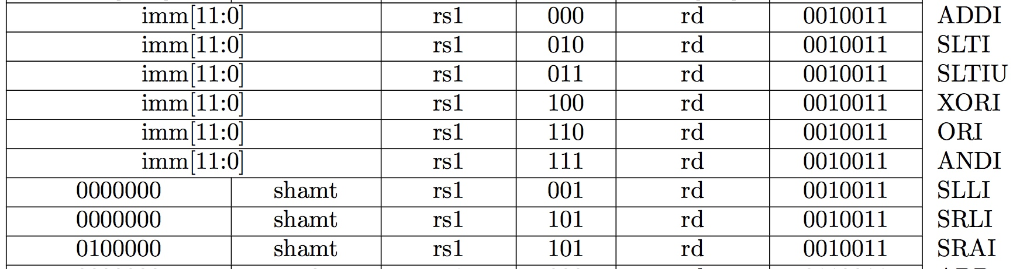
All RV32 I-format Arithmetic Instructions
One of the higher-order immediate bits is used to distinguish “shift right logical” (SRLI) from “shift right arithmetic” (SRAI)
“Shift-by-immediate” instructions only use lower 5 bits of the immediate value for shift amount (can only shift by 0-31 bit positions)
Prof Krste Asanović & Randy H. Katz, Univ of California, Berkeley

Slide 13
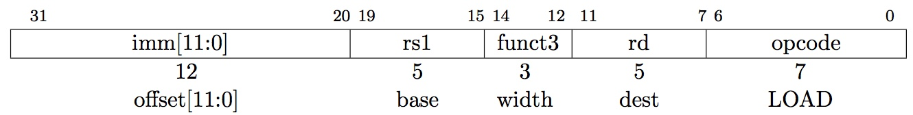
Load Instructions are also I-Type
The 12-bit signed immediate is added to the base address in register rs1 to form the memory address
This is very similar to the add-immediate operation but used to create address not to create final result
The value loaded from memory is stored in register rd
Prof Krste Asanović & Randy H. Katz, Univ of California, Berkeley

Slide 14
I-Format Load Example
RISC-V Assembly Instruction:
lw x14, 8(x2)
000000001000
00010
010
01110
0000011
imm=+8
rs1=2
LW
rd=14
LOAD
Prof Krste Asanović & Randy H. Katz, Univ of California, Berkeley

Slide 15
I-Format More Example
Note the differing order of operands in assembly and machine codes:
addi rd, rs1, imm
lw rd, imm(rs1)
Ref: Harris and Harris Book: Digital Design and Computer Architecture: RISC-V Edition

Slide 16
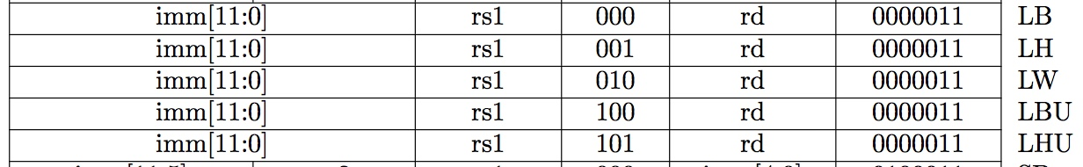
All RV32 Load Instructions
funct3 field encodes size and signedness of load data
LBU is “load unsigned byte”
LH is “load halfword”, which loads 16 bits (2 bytes) and sign-extends to fill destination 32-bit register
LHU is “load unsigned halfword”, which zero-extends 16 bits to fill destination 32-bit register
There is no LWU in RV32, because there is no sign/zero extension needed when copying 32 bits from a memory location into a 32-bit register
Prof Krste Asanović & Randy H. Katz, Univ of California, Berkeley

Slide 17
S-Format

Slide 18
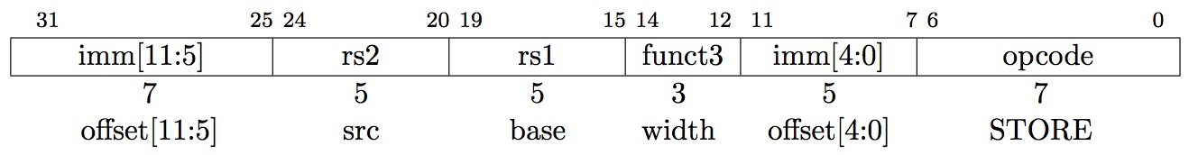
S-Format Used for Stores
Store needs to read two registers, rs1 for base memory address, and rs2 for data to be stored, as well as need immediate offset
Note that stores don’t write a value to the register file, unlike rd!
RISC-V design decision is move low 5 bits of immediate to where rd field was in other instructions – keep rs1/rs2 fields in same place
register names more critical than immediate bits in hardware design
imm: 12-bit two’s complement immediate
Prof Krste Asanović & Randy H. Katz, Univ of California, Berkeley

Slide 19
S-Format Example
RISC-V Assembly Instruction:
sw x14, 8(x2)
0000000
01110
00010
010
01000
0100011
offset[11:5]
=0
rs2=14
rs1=2
SW
offset[4:0]
=8
STORE
0000000
01000
combined 12-bit offset = 8
Prof Krste Asanović & Randy H. Katz, Univ of California, Berkeley

Slide 20
S-Format: More examples
Note the differing order of operands in assembly and machine codes:
sw rs2, imm(rs1)
Ref: Harris and Harris Book: Digital Design and Computer Architecture: RISC-V Edition

Slide 21
All RV32 Store Instructions
Prof Krste Asanović & Randy H. Katz, Univ of California, Berkeley

Slide 22
Conditional Branches B-Format

Slide 23
Branching Instructions
beq, bne, bge, blt
Need to specify an address to go to
Also take two registers to compare
How to encode label, i.e., where to branch to?
Prof Krste Asanović & Randy H. Katz, Univ of California, Berkeley

Slide 24
Branching Instruction Usage
Branches typically used for loops
if-else, while, for
Loops are generally small (< 50 instructions)
Function calls and unconditional jumps handled with jump instructions (J-Format)
Recall: Instructions stored in a localized area of memory (Code/Text)
Largest branch distance limited by size of code
Address of current instruction stored in the program counter (PC)
∞
stack
heap
static data
code
0
Prof Krste Asanović & Randy H. Katz, Univ of California, Berkeley

Slide 25
RISC-V B-Format for Branches
B-format is mostly same as S-Format
3 operands
rs1: register source 1
rs2: register source 2
imm_{12:1}: 12-bit two’s complement immediate – address offset
But now immediate represents values -4096 to +4094 in 2-byte increments
The 12 immediate bits encode even 13-bit signed byte offsets (lowest bit of offset is always zero, so no need to store it)
Prof Krste Asanović & Randy H. Katz, Univ of California, Berkeley

Slide 26
RISC-V Conditional Branches
Example: BEQ x1, x2, Label
Branches read two registers but don’t write a register (similar to stores)
How to encode label, i.e., where to branch to?
Prof Krste Asanović & Randy H. Katz, Univ of California, Berkeley

Slide 27
PC-Relative Addressing
PC-Relative Addressing: Use the immediate field as a two’s complement word offset to PC
Branches generally change the PC by a small amount
Can specify ± 2¹² addresses from the PC
Why not use byte address offset from PC as the immediate?

Slide 28
Branching Reach
Recall: RISCV uses 32-bit addresses, and memory is byte-addressed
Instructions are “word-aligned”: Address is always a multiple of 4 (in bytes)
PC ALWAYS points to an instruction
Let immediate specify #words instead of #bytes
Instead of specifying ± 2¹¹ bytes from the PC, we will now specify ± 2¹¹ words = ± 2¹³ byte addresses around PC
As the last two bits of word address are always 0,
we don’t need to encode them.
However, we use total 13 bits instead of possible 14 bits.
Prof Krste Asanović & Randy H. Katz, Univ of California, Berkeley
Notes:
Locker room analogy

Slide 29
Branch Calculation
If we don’t take the branch:
PC = PC+4 = next instruction
If we do take the branch:
PC = PC + (immediate*4)
Observations:
immediate is number of instructions to move (remember, specifies words) either forward (+) or backwards (–)
Prof Krste Asanović & Randy H. Katz, Univ of California, Berkeley

Slide 30
RISC-V Feature, n×16-bit instructions
Extensions to RISC-V base ISA support 16-bit compressed instructions and also variable-length instructions that are multiples of 16-bits in length
16-bit = half-word
To enable this, RISC-V scales the branch offset to be half-words even when there are no 16-bit instructions
Reduces branch reach by half and means that ½ of possible targets will be errors on RISC-V processors that only support 32-bit instructions
RISC-V conditional branches can only reach ± 2¹⁰ × 32-bit instructions either side of PC
Prof Krste Asanović & Randy H. Katz, Univ of California, Berkeley

Slide 31
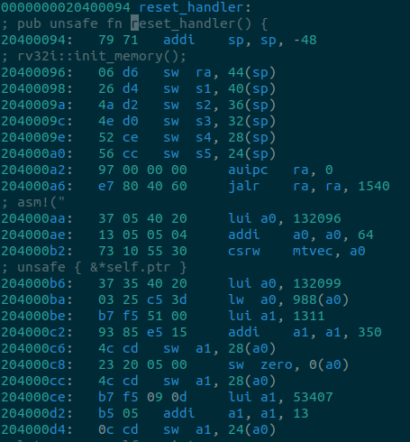
Example Instruction Compression
Code taken from Tock embedded operating system

Slide 32
RISC-V B-Format for Branches
Prof Krste Asanović & Randy H. Katz, Univ of California, Berkeley
B-format is mostly same as S-Format, with two register sources (rs1/rs2) and a 12-bit immediate
But now immediate represents values -2¹² to +2¹²-2 in 2-byte increments
The 12 immediate bits encode even 13-bit signed byte offsets (lowest bit of offset is always zero, so no need to store it)
31
0
imm[12|10:5]
rs2
rs1
func3
imm[4:1|11]
opcode
7
5
5
3
5
7

Slide 33
Branch Example (1/2)
RISCV Code:
Loop: beq x19,x10,End add x18,x18,x10 addi x19,x19,-1 j Loop End: <target instr>
Branch offset =
(Branch with offset of 0, branches to itself)
Start counting from instruction AFTER the branch
1
2
3
4
4×32-bit instructions = 16 bytes
Prof Krste Asanović & Randy H. Katz, Univ of California, Berkeley

Slide 34
Branch Example (1/2)
RISCV Code:
Loop: beq x19,x10,End add x18,x18,x10 addi x19,x19,-1 j Loop End: <target instr>
Start counting from instruction AFTER the branch
1
2
3
4
7
5
5
3
5
7
31
0
???????
01010
10011
000
?????
1100011
rs2=10
rs1=19
BEQ
BRANCH
Prof Krste Asanović & Randy H. Katz, Univ of California, Berkeley

Slide 35
Branch Example (1/2)
beq x19,x10,offset = 16 bytes
13-bit immediate, imm[12:0], with value 16 0000000010000
imm[0] discarded, always zero
31
0
0 000000
01010
10011
000
1000 0
1100011
imm[12|10:5]
imm[4:1|11]
Prof Krste Asanović & Randy H. Katz, Univ of California, Berkeley

Slide 36
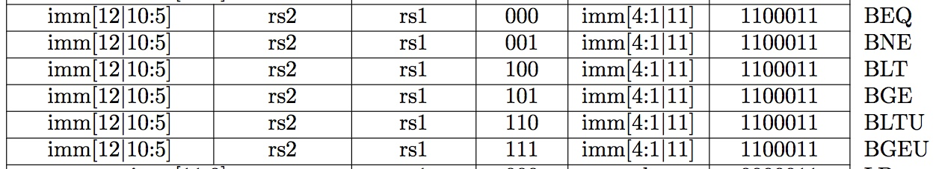
All RISC-V Branch Instructions
Prof Krste Asanović & Randy H. Katz, Univ of California, Berkeley

Slide 37
U-type

Slide 38
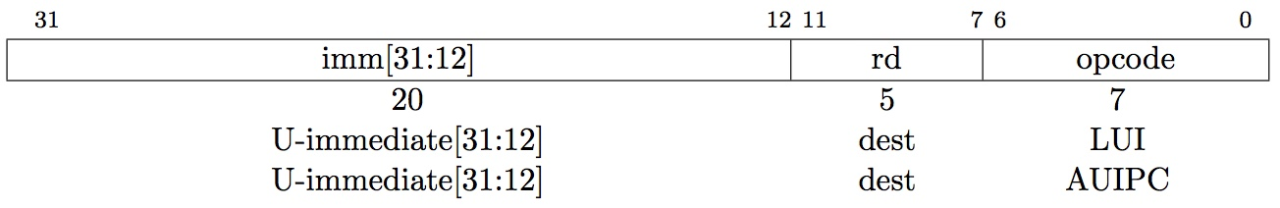
U-Type for Upper Immediate Instruction
Upper Immediate Type
2 operands:
rd: destination register
imm_{31:12}:upper 20 bits of a 32-bit immediate
Used for two instructions
LUI – Load Upper Immediate
AUIPC – Add Upper Immediate to PC
Ref: Harris and Harris Book: Digital Design and Computer Architecture: RISC-V Edition

Slide 39
lui Example
Ref: Harris and Harris Book: Digital Design and Computer Architecture: RISC-V Edition

Slide 40
lui to create long immediates (Revise)
LUI writes the upper 20 bits of the destination with the immediate value, and clears the lower 12 bits
Together with an ADDI to set low 12 bits, can create any 32-bit value in a register using two instructions (LUI/ADDI)
lui x10, 0x87654 # x10 = 0x87654000
addi x10, x10, 0x321 # x10 = 0x87654321
Remember the corner case – discussed earlier
Ref: Harris and Harris Book: Digital Design and Computer Architecture: RISC-V Edition

Slide 41
AUIPC: Add Upper Immediate to pc
It is used to build pc-relative addresses using U-type format
Form a 32-bit offset
Offset = 20-bit U-immediate + filling in the lowest 12 bits with zeros,
PC + Offset → Destination Register
Used for PC-relative addressing
Label: AUIPC x10, 0 # Puts address of label in x10
Ref: Harris and Harris Book: Digital Design and Computer Architecture: RISC-V Edition

Slide 42
Summary of RISC-V instruction Formats

Slide 43
Class Summary
In this class we have studied RISC-V instructions
R-Format
I-Format
S-Format
B-Format
U-Format

Slide 44
Backup Slides

Slide 45
B-Type Example (1/2)
The 13-bit immediate encodes where to branch (relative to the branch instruction)
Immediate encoding is strange
Example:
Ref: Harris and Harris Book: Digital Design and Computer Architecture: RISC-V Edition

Slide 46
B-Type Example (2/2)
Note the differing order of operands in assembly and machine codes:
beq rs1, rs2, imm_{12:1}
Ref: Harris and Harris Book: Digital Design and Computer Architecture: RISC-V Edition

Slide 47
PC-Relative Addressing
In the Branch Instruction, we have used PC-relative addressing
PC-Relative Addressing: Use the immediate field as a two’s-complement offset to PC
Branches generally change the PC by a small amount
Can specify ± 2¹² addresses from the PC in two byte increment
We will study Addressing methods in the next class
Prof Krste Asanović & Randy H. Katz, Univ of California, Berkeley

